Slide 1

Halloween challenge
Computational Intelligence 2023/2024
Mattia Sabato – S305849
Claudio Savelli – S317680

Slide 2
introduction

Slide 3

Set Covering Problem
Problem Statement:
Given a finite set U of elements and a family S of subsets of U, the Set Covering Problem aims to find the smallest possible subfamily S' of S such that the union of the subsets in S' covers all elements in U.
Mathematical Formulation:
U: The universal set of elements to be covered.
S: A family of subsets of U, where each subset s in S has a cost associated with it.
S': The selected subfamily of subsets from S to cover all elements in U.
C(s): The cost associated with subset s.
X(s): A binary decision variable that is equal to 1 if subset s is selected in S', and 0 otherwise.
The goal is to minimize the total cost of the selected subsets:
Minimize: Σ (C(s) * X(s)) for all subsets s in S'
Subject to the constraint that every element in U must be covered:
Σ (X(s)) ≥ 1 for all elements in U
Objective:
Find a subfamily S' of subsets from S that minimizes the total cost while ensuring that every element in U is covered at least once.
The Set Covering Problem is known to be NP-hard, which means that there is no known efficient algorithm to solve it optimally for large instances. Various approximation algorithms and heuristics are often used to find near-optimal solutions in practice. It has applications in various real-world problems, including facility location, airline crew scheduling, and many other fields where resource allocation and coverage are essential considerations.

Slide 4
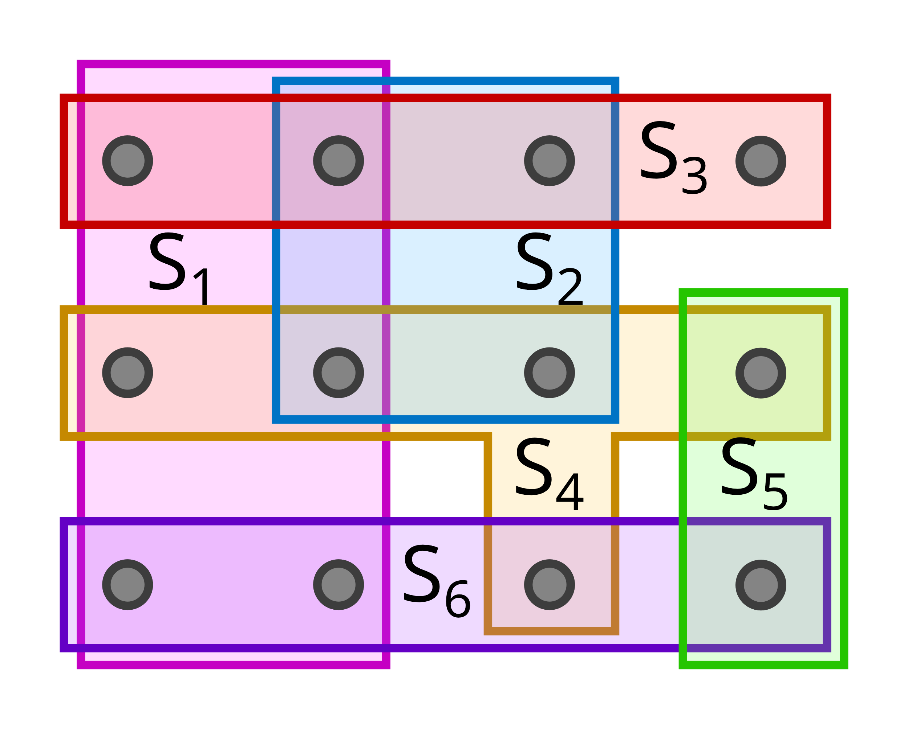

Set Covering Problem

Slide 5


Proposed Methodologies
benchmark
Baseline
Our solution
Notes:
Upper and lower bound

Slide 6
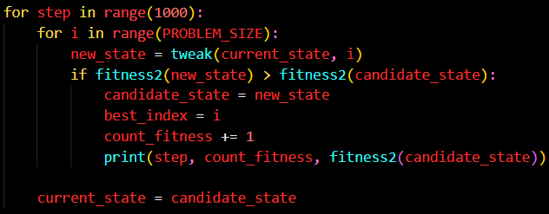
benchmark
Extensive search
At each step, the best set to take (or remove) is evaluated.
Only the best one is retained.

Slide 7
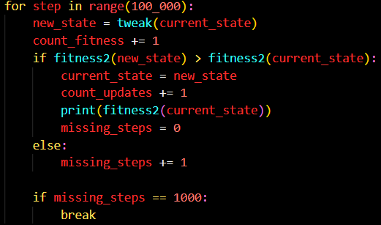
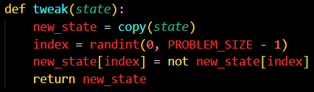
baseline
The baseline was evaluated by taking or removing a random element in SETS before calling the fitness function.

Slide 8
Our method

Slide 9
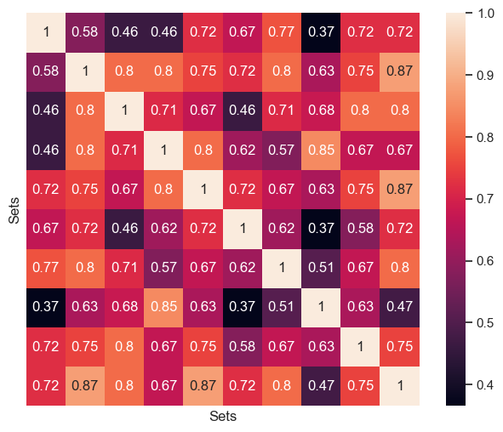
OUR SOLUTION
We precompute the distance between sets, tuning three different metrics:

Slide 10

OUR SOLUTION
We precompute the distance between sets, tuning three different metrics:
Euclidean Distance
COSINE SIMILARITY
MANHATTAN DISTANCE

Slide 11
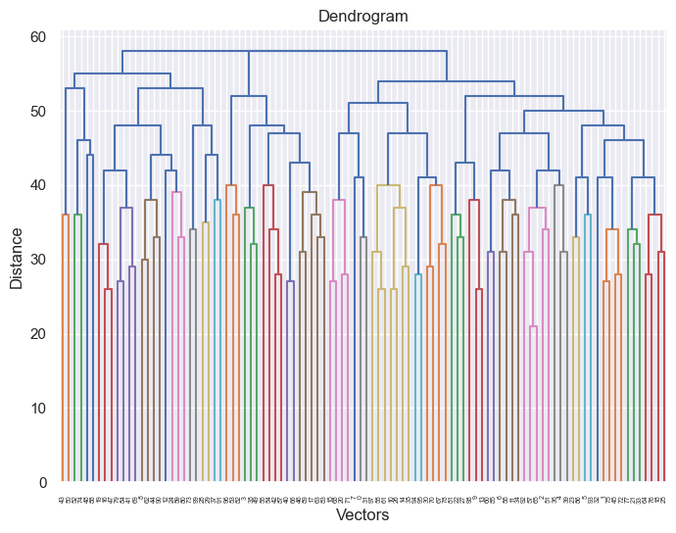
OUR SOLUTION
We cluster the SETS considering the metric…

Slide 12
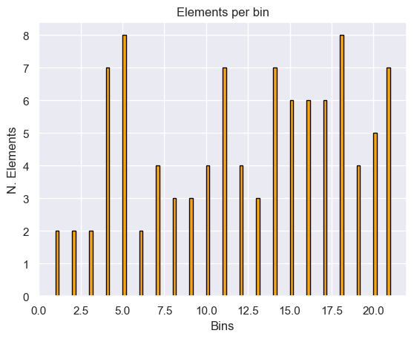
OUR SOLUTION
We cluster the SETS considering the metric…
…and, by cutting at a given threshold, we can tune the cardinality of each cluster!

Slide 13

OUR SOLUTION
Then we sample just one set from each cluster and we evaluate the fitness considering the actual state and each of the candidates. Finally we choose the best and we get closer to the goal!

Slide 14
CAN WE DO BETTER?

Slide 15
OUR SOLUTION
Instead of sampling from every cluster, we decide to prune the ones that are statistically similar to our current solution.

Slide 16
OUR SOLUTION
Instead of sampling from every cluster, we decide to prune the ones that are statistically similar to our current solution.
We would be perfect together, we are so similar!!!
For each cluster, we compute the probability to find a given element and we compute the (manhattan, but tunable) distance from the actual solution. Finally, we sample only from the top-n less similar clusters.

Slide 17
Results

Slide 18

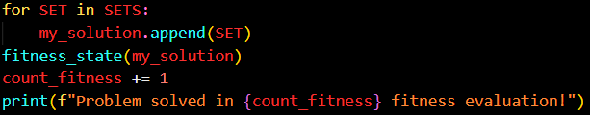

Slide 19
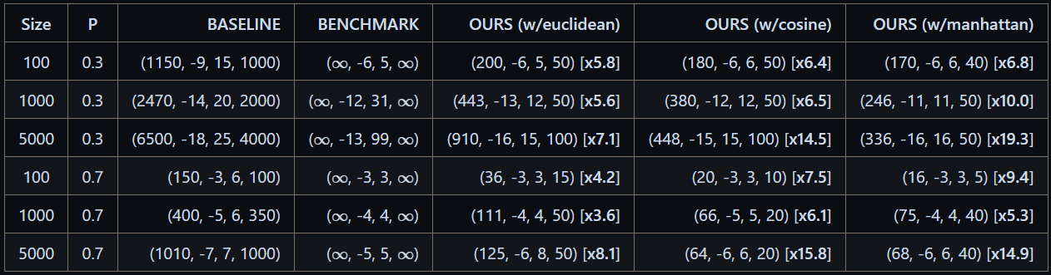
Experimental results
Experiments with different distances compared against the BASELINE (Random Tweaking) and the BENCHMARK (Steepest Ascent).
(#fitness_calls, cost, #steps, #steps_with_no_improvements_to_stop) [comparison_with_baseline]

Slide 20
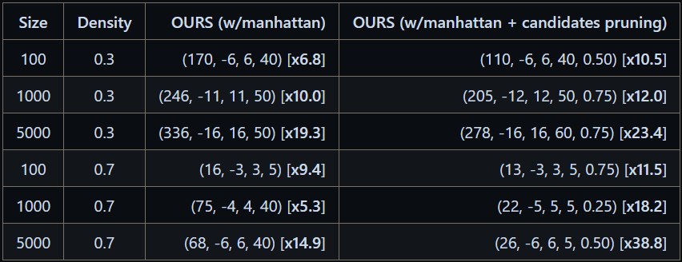

Experimental results
Experiments testing the effectiveness of candidates pruning.
(#fitness_calls, cost, #steps, #steps_with_no_improvements_to_stop, ratio_candidates kept*) [comparison_with_baseline]
*Only for candidates pruning

Slide 21
Future works

Slide 22


Future works
automatic threshold
selection
N-elements tweak

Slide 23


Thank you!
Mattia Sabato – S305849
Claudio Savelli – S317680

